Slide 1

COMP3200: Individual Project Demonstration Video
Title: Machine Learning to Detect Malicious URLs
Student: Edward Gorman
Supervisor: Dr Enrico Gerding
Examiner: Dr Age Chapman
Notes:
Hello and welcome to my demonstration video for COMP3200 Individual Project. My project is titled “Machine Learning to Detect Malicious URLs” and was submitted for the award of a Bachelor of Science degree in Computer Science.

Slide 2
Project Overview
Develops a malicious URL detection system for the purpose of preventing user access to malicious Web pages.
Considers different feature representations of a URL including lexical, host and content-based properties.
Explores a range of model configurations surveying both shallow (e.g. Support Vector Machines) and deep learning (e.g. Neural Networks).
Notes:
This report provides a comprehensive analysis for the development of a malicious URL detection system using machine learning by providing a holistic overview of previously researched and novel techniques to determine the most effective approach. It explores numerous feature representations of the URL including lexical, host, and content-based properties as well as a wide range of model configurations surveying both shallow and deep learning techniques.

Slide 3
Problem Setting
Malicious URLs are websites that perform actions to harm and/or confound users.
Current solution ‘blacklisting’ lists all known malicious URLs and checks against this list before allowing a user to access a URL.
This technique is ineffective due to the quantity of malicious websites generated daily that have never been classified before.
Notes:
Malicious URLs are defined as sites that perform actions to harm and or confound users, and the three most common attack types include phishing attempts, malware installations, and spam sites. The current method for handling this is blacklisting, which is a database of all known malicious URLs which can be queried to check if it contains a URL the user is about to access. However, this approach is becoming increasingly inadequate due to the large number of malicious sites generated daily, particularly those that comprise slight variations of URLs that have been blocked previously.

Slide 4
Proposed Solution
Machine learning can be applied to learn an effective feature representation of malicious URLs.
This knowledge would be generalised such that an unknown URL may be classified as either malicious or benign.
This approach could be used as a replacement or supplement to blacklist depending on its effectiveness.
Notes:
This research proposes applying machine learning to learn effective feature representations of a malicious URL and generalise these characteristics such that unknown URLs may be correctly classified as either malicious or benign. This approach could be used as a replacement or supplement to the existing blacklist technology depending on its effectiveness.

Slide 5
Related Works
Critically evaluates existing research related to the topic of Malicious URL detection using machine learning.
Works are organised thematically by their feature representation and algorithm implementation.
In summary: it is a well explored area but few provide a holistic overview and few assess their ability to capture all malicious URLs.
Notes:
My report critically evaluates previous research in this field, assessing their contents thematically by feature representation and algorithm implementation and highlighting their respective advantages and disadvantages. I summarise that few papers compare the full range of techniques available, and few assess their model’s ability to capture all malicious URLs and instead focus on performance metrics such as accuracy.

Slide 6
Methodology (1/4)
1,855,369 URLs were accumulated from several blacklist and whitelist sources (see Appendix A for list of URL sources) of which 27.5% are malicious, 72.5% are benign.
Additional metadata was collected via automated Python scripts which take a few seconds per URL.
Data cleaning is used to account for repeat entries, malformed requests, and missing data.
Notes:
To begin this research, a large collection of malicious and benign URLs were accumulated from several blacklist and whitelist sources, accumulating 1.8 million URLs of which 27.5% are malicious and 72.5% are benign. Lexical features could be extracted from the URL itself, but host and content-based analysis required an automated script to gather information via Whois and Get requests. Once collected, the data undergoes a one-time cleaning process to remove duplicates and adjust malformed or missing data entries.

Slide 7
Methodology (2/4)
The data then undergoes feature extraction depending on the feature representation being investigated.
1/3 of all features investigated in this report are novel while the remaining have been previously researched.
These can be assessed individually or all together per source of feature representation.
Notes:
Once loaded, the data undergoes a feature extraction process depending on the type of feature representation being investigated which is either lexical, host, or content based. Of these techniques one-third are novel with the remaining features having been investigated in previous research. They are assessed on an individual level and all combined together to provide an analysis of the feature representation as a whole.

Slide 8
Methodology (3/4)
The shallow learning models are implemented using the Python module Sci-kit learn.
The deep learning models are implemented using the Python module Keras.
Models undergo additional data processing and hyperparamter tuning depending on their configuration.
Notes:
Support Vector Machines, Random Forest and Perceptron were implemented using the Python module Sci-kit learn, whereas the convolutional neural networks were implemented using the Python module Keras. The SVM and Perceptron models required additional data processing to standardise and scale the data of each feature dimension, and all models underwent hyperparameter tuning before training to optimise their fixed characteristics.

Slide 9
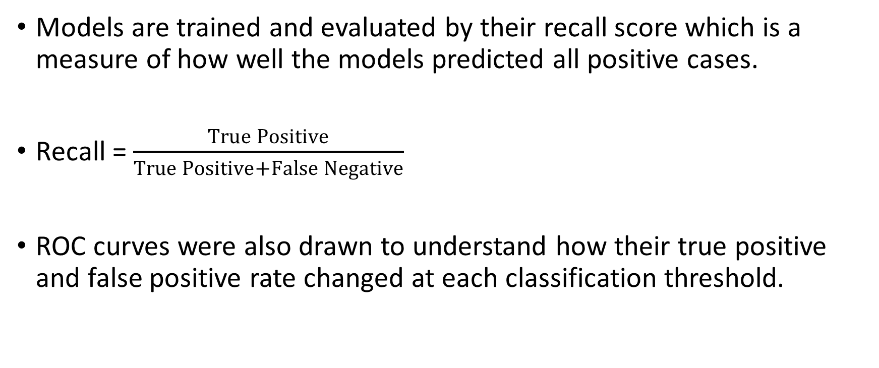
Methodology (4/4)
Models are trained and evaluated by their recall score which is a measure of how well the models predicted all positive cases.
Recall = $\frac{True Positive}{True Positive+False Negative}$
ROC curves were also drawn to understand how their true positive and false positive rate changed at each classification threshold.
Notes:
The models in this report were trained to output the highest recall score their algorithm could achieve. In addition, ROC curves were drawn to demonstrate how the true positive and false positive rate of each model would change as the classification threshold for deciding whether an instance is malicious or not, varied. This analysis provided a thorough understanding of the ability of each model to detect malicious URLs.

Slide 10
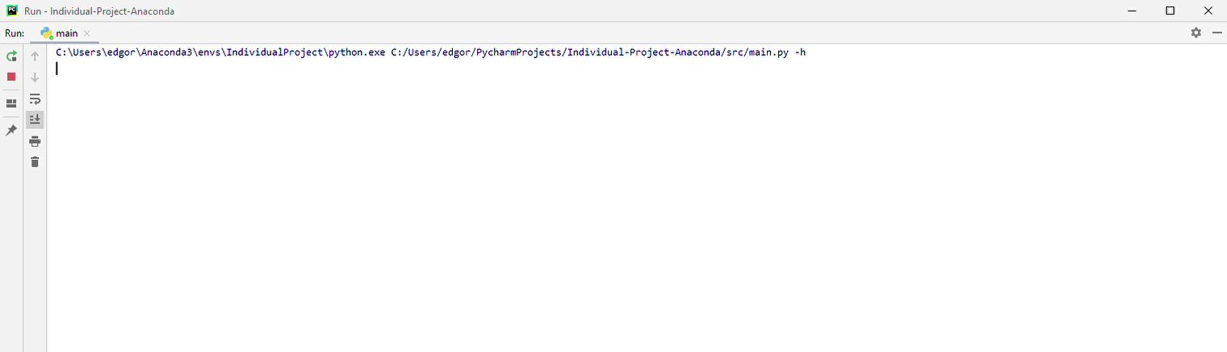
Project Demonstration
Notes:
This demonstrates the help message displayed when the program is run.

Slide 11
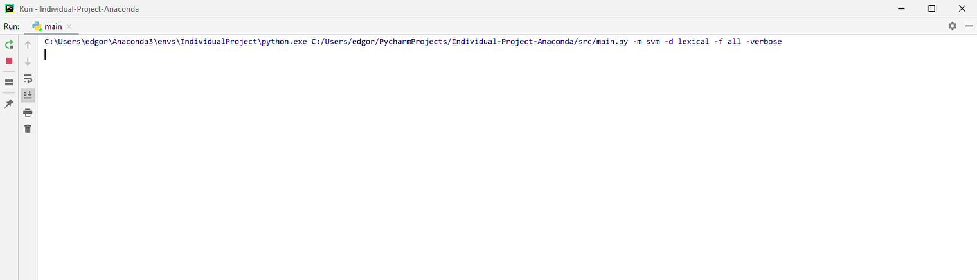
Project Demonstration
Notes:
This demonstrates a specific model and feature set being tested using stored data

Slide 12
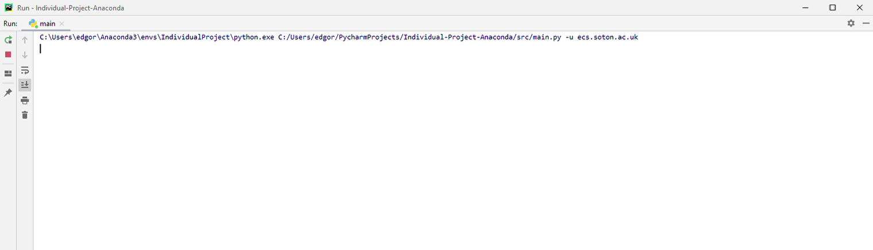
Project Demonstration
Notes:
This demonstrates the system predicting a whether ecs.soton.ac.uk is malicious using the best model.

Slide 13
Evaluation
Content-based properties reported the highest recall scores, followed by lexical-based and finally host-based properties.
Random Forest algorithm across every feature representation performed the best, with content-based analysis achieving the highest AUC score of 0.95.
The project achieved its goals and completed the work on schedule (except for optional extension).
Notes:
My evaluation found that a random forest algorithm applied to content-based techniques achieved the greatest performance with an area under curve score of 0.95 on the ROC plots. It also managed to achieve a recall score of 0.995 meaning it managed to successfully detect almost all malicious URLs that had never been seen before. Overall this project was successful in achieving its goals, except for the optional extension to construct a user interface which ended up being the command line interface shown previously.

Slide 14
Conclusions
Lexical techniques alone are not sufficient to capture a majority of malicious URLs. Content-based properties may be considered due to their effectiveness at discriminating malicious from benign sources.
The Random Forest learning algorithm was the most effective technique routinely achieving the highest performance.
It is recommended this system be implemented alongside a blacklist component purely for unknown URLs.
Notes:
To conclude, my research found that lexical techniques were not sufficient to reliably detect all malicious URLs and as such content-based properties may be used in addition to help discriminate malicious from benign sources. The most effective learning technique was Random Forest scoring better than all other approaches. Despite this, it is recommended that such a system be implemented alongside a blacklisting technique for URLs which have not been classified before to ensure known malicious sites do not escape detection.

Slide 15
Further Research
Additional content-based analysis including visual inspection of Web pages.
More advanced deep learning techniques including LSTM which include feedback connections.
Natural language processing techniques for lexical and content-based information.
Notes:
This research could be extended to investigate the following: visual representations of the Web page to gain a better understanding of the layout, more advanced deep learning techniques including long short term memory neural networks, and natural language processing techniques due to the success of the bag of words approach found in this report.

Slide 16
Thank you for watching.
Edward Gorman
eg6g17@soton.ac.uk

